Slide 1
Chord Distributed Hash Table
Reference
Ion Stoica, Robert Morris, David Karger, M. Frans Kaashoek, and Hari Balakrishnan. “Chord: A scalable peer-to-peer lookup service for internet applications.” In Proc. Of SIGCOMM '01, San Diego, 2001.

Slide 2
NoSQL Systems
Key-value stores
Document stores
Graph databases
(Wide) column stores
MongoDB
CouchDB
Dynamo
Voldemort
Neo4J
AllegroGraph
HBase
Cassandra
http://nosql-database.org/
Notes:
Flexible schema, horizontal scaling, flexible ACID, Not only SQL

Slide 3
Peer-to-Peer Systems
Given a larger network of peers, how can we locate the peer that stores a particular data item efficiently?
Unstructured P2P networks
Data item (or key-value pair) of a peer is stored at its location
Given a key, it is not easy to figure out who all store it
A peer can select any other peer as its neighbor
E.g., Napster, Kazaa, BitTorrent
Flooding queries, index to quickly locate a data item
Structured P2P networks
Given a key, the peer that stores it can be found quickly
A peer selects only certain other peers as its neighbors
Where to store a key is determined after applying a hash function
Notes:
Play the role of client and server – peer-to-peer; BitCoin, blockchain

Slide 4
Distributed Hash Table
Load balancing
Spread keys evenly over nodes with high probability
Natural load balance
Decentralization
Fully distributed – every node is equally important
No single point of failure
Scalability
O(log(N)) cost factor – communication, routing state, lookup, etc.
Availability
New nodes can join, existing nodes can fail
Notes:
Consistent hashing: like other hashing it distributes keys almost evenly across buckets
Unlike other hashing functions, only a fraction of keys need to be redistributed when the # of buckets changes.

Slide 5
Consistent Hashing in Chord
cat
SHA-1 hashing algorithm is used to map both nodes and keys onto the ring
peer
apple
key
For a node, use its IP address (+ port #)
Chord ring
(160-bit address space)
For a key, just use the same
eagle
With high probability, the hash function ensures that all nodes receive roughly the same # of keys
lion
zebra
Notes:
Voldemort 120 bits.
When a node leaves, only a fraction of keys needs to be moved.

Slide 6
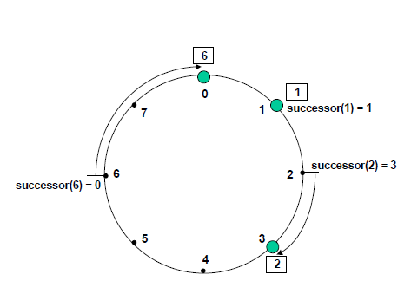
Successor of a Key
3-bit identifier space
Source: Stoica et.al., SIGCOMM 2001
Successor denotes the peer responsible for storing a key

Slide 7
Scalable Key Location
Suppose each node knows its successor node in the ring
Can pass the key along the circle
May need N hops ☹
How can this be improved?
Solution: Finger table
O(log N) hops ☺

Slide 8
Finger Table
Each node/peer maintains a routing table
The # of entries in this table is O(log N) or m where m is the # of bits used for ids
Each entry has a start, interval, successor
For a given node (with id) k, its first interval starts from [k+1, k+2) , and then its size doubles
Non-overlapping intervals
This doubling enables us to cover the entire ring in O(log N) steps
start | interval | successor
Notes:
Think of binary search: halving in log(N) steps

Slide 9
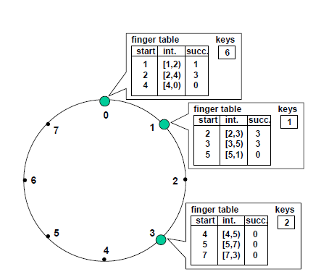
Finger Table: Example
Source: Stoica et.al., SIGCOMM 2001
Notes:
Finger table exists only where there is a peer!
O(log N) entries or m entries in each finger table

Slide 10
How to find successor(k)?
Suppose a peer wants successor(k) i.e., any arbitrary key k
Find the peer that is responsible for storing k
If k matches a start entry in its finger table, then its successor is known
If k lies within the interval of an entry and the successor entry is ≥ k, then we are done

Slide 11
Example
Suppose node 0 wants to
know the successor of 1.
Suppose node 0 wants to
know the successor of 3.

Slide 12
How to find successor(k)?
Otherwise, the successor value in the entry is the node that most immediately precedes k (among all the successor values in the finger table)
Then we ask that node for successor(k)
Each time you try to go to a node that is closer to k in the ring
The distance to the target is reduced by half each time (like binary search)

Slide 13
Example
Suppose node 3 wants to know the successor of 1.
Does not have 1 in its start column
Finds [7,3) to contain 1
Successor of 7 is 0 and id 0 < 1; node 0 most immediately precedes 1
Send a request to node 0 to find successor of 1
Node 0 sees id 1 match a start entry in its finger table
Returns “1” back to node 3
Source: Stoica et.al., SIGCOMM 2001

Slide 14
Replication
Store r copies of a (k,v) pair on r successors of k
Allows to cope with failures
See paper for how to cope with nodes leaving and joining the network
Notes:
Peers run a stabilization algorithm to know each others successors/predecessors

